Slide 1

Feature Extraction and Mobile Price Prediction
Title- Mobile Price Pridiction with ML Models
Name- Yamini Nagpure

Slide 2
Introduction
Objective:-
• To apply machine learning algorithms to predict outcomes based on the dataset provided.
•To compare performance and tune for better results.
Algorithms Covered:-
• Linear Regression
• RandomForest Regression.
• XGBoost Regression
• Logistic Regression

Slide 3
Project Description:-
In this project we will work with dataset that contains detailed information about mobile phones including their Models, Colour, Memory, AI lens, Processor, Battery, Mobile height, RAM, Rear Camera, Front Camera,and most importantly Price..
Goal:-
Main goal is to develop predictive model for mobile phone prices.

Slide 4
Problem Statement:
There are many things we consider before buying a mobile as we used our mobile for various purpose like connecting with our family & Office Colleagues, playing games, taking a photos to keep our memory alive. So, this such specifications such as RAM, memory, battery, camera, connectivity etc. plays important role to buy a mobile. To analysis of this important factor from time to time and come up with the best setoff specifications and price ranges so that people will buy the mobile . Hence through the various ML modules we will help the company to estimate the price of mobiles according to feature so the maximum amount of sell will be possible.

Slide 5
Dataset Overview:
The dataset contains the following key features-
RAM
MEMORY
BATTERY
REAR CAMERA
FRONT CAMERA
PROCESSOR
PRICE
SOURCE: PPROCESSED_FLIPDATA.xlsx

Slide 6
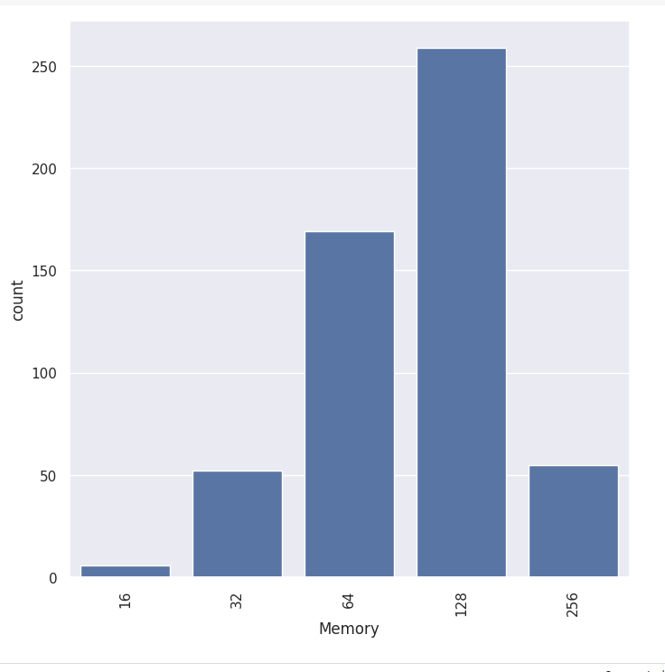
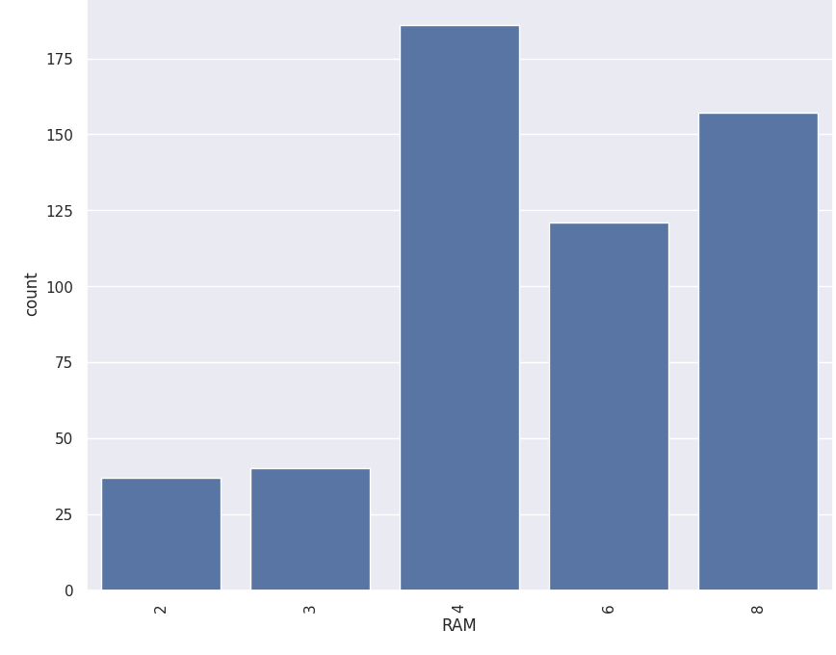
Memory RAM
Most of the mobile phones has 128 GB memory it suggest that this memory size are common.
4 GB , 6GB and 8GB indicates the most common RAM size among the mobile phones.

Slide 7
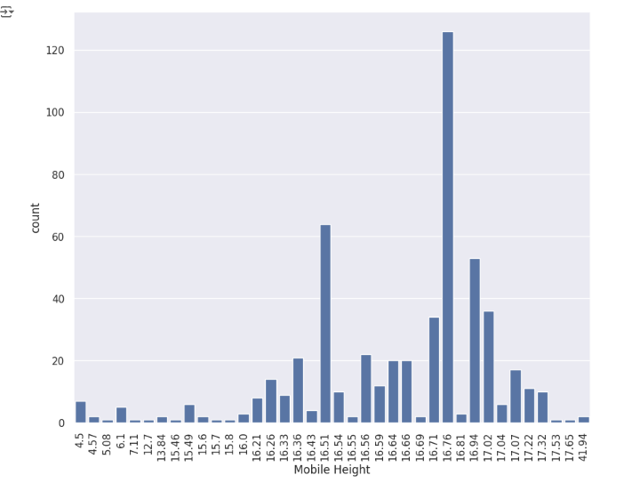
Mobile Height
16.7 inch height handset are having maximum presence in the distribution it indicate that most phones fall within a standard height range

Slide 8
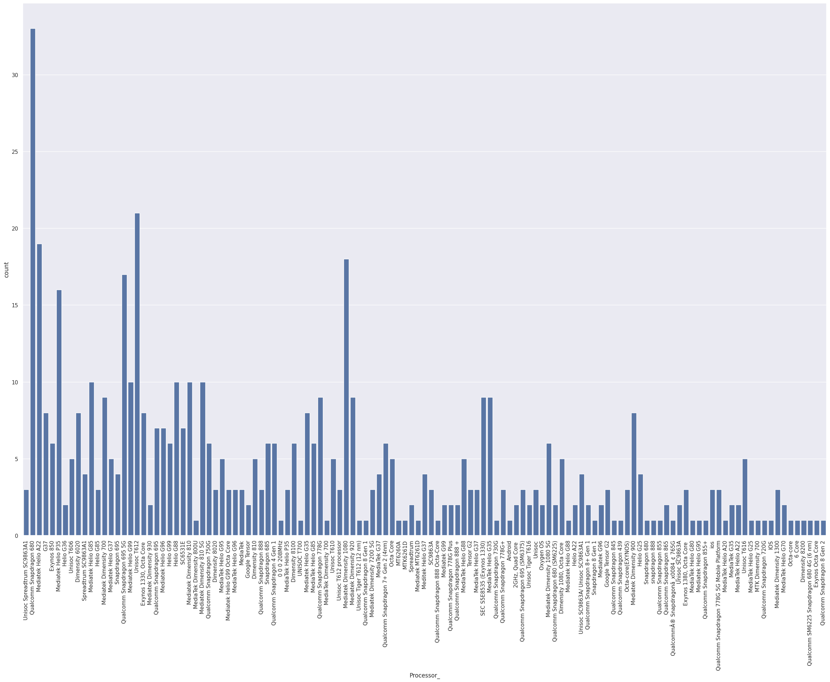
Processor
Quallomm SnapDragon processor are mostly used in mobile phones

Slide 9
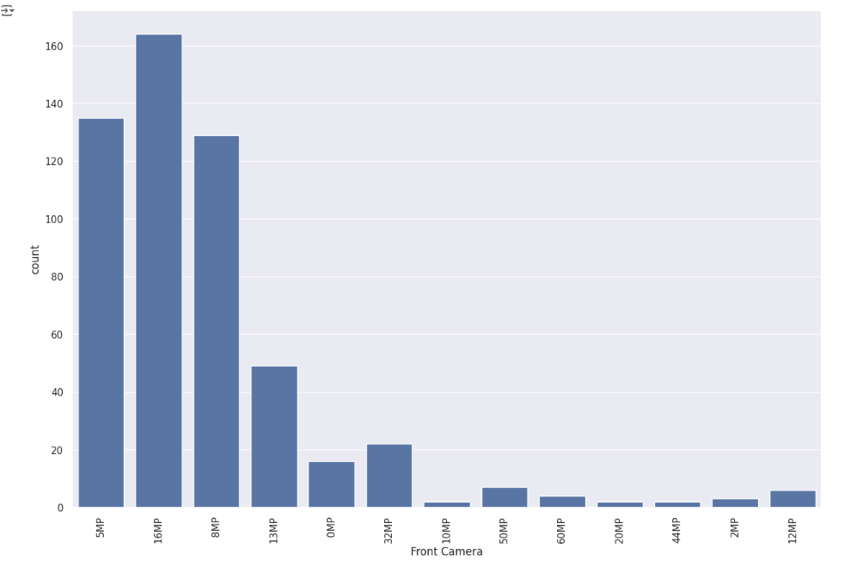
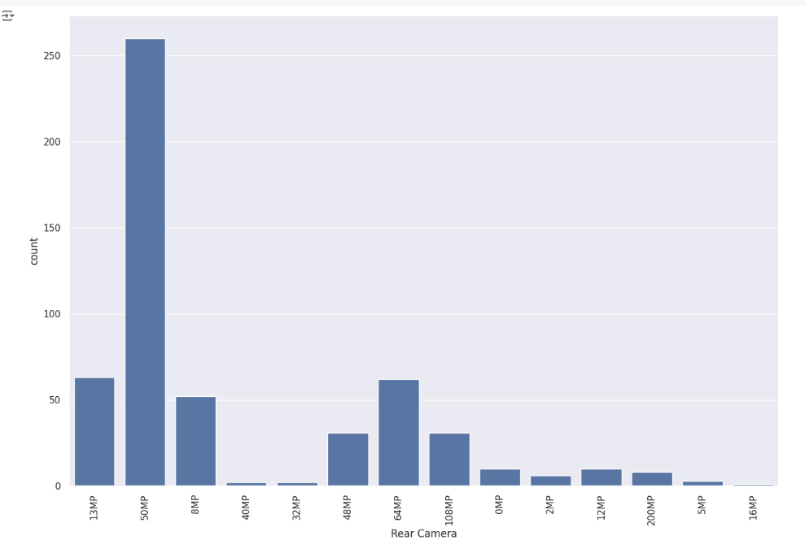
Front Camera Rere Camera
Front camera shows phones with 16MP are most common.
Rear camra with 50MP are most common

Slide 10
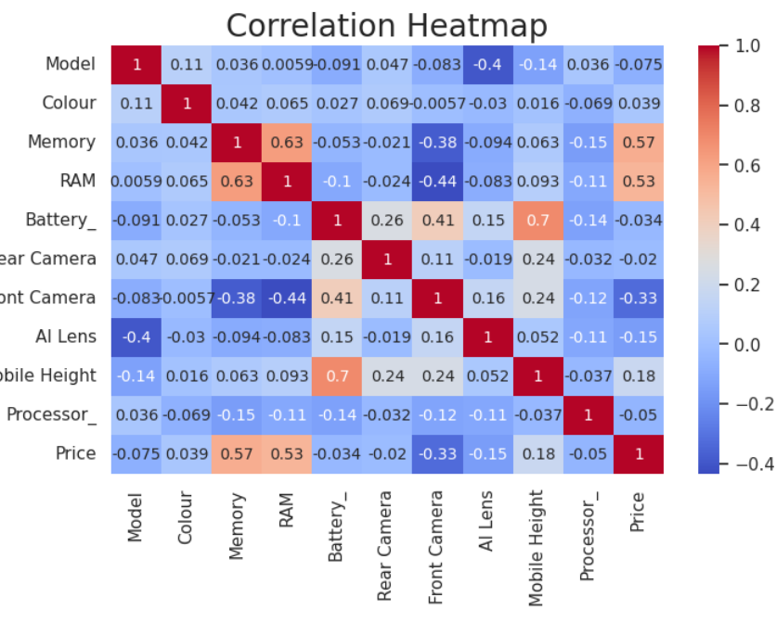
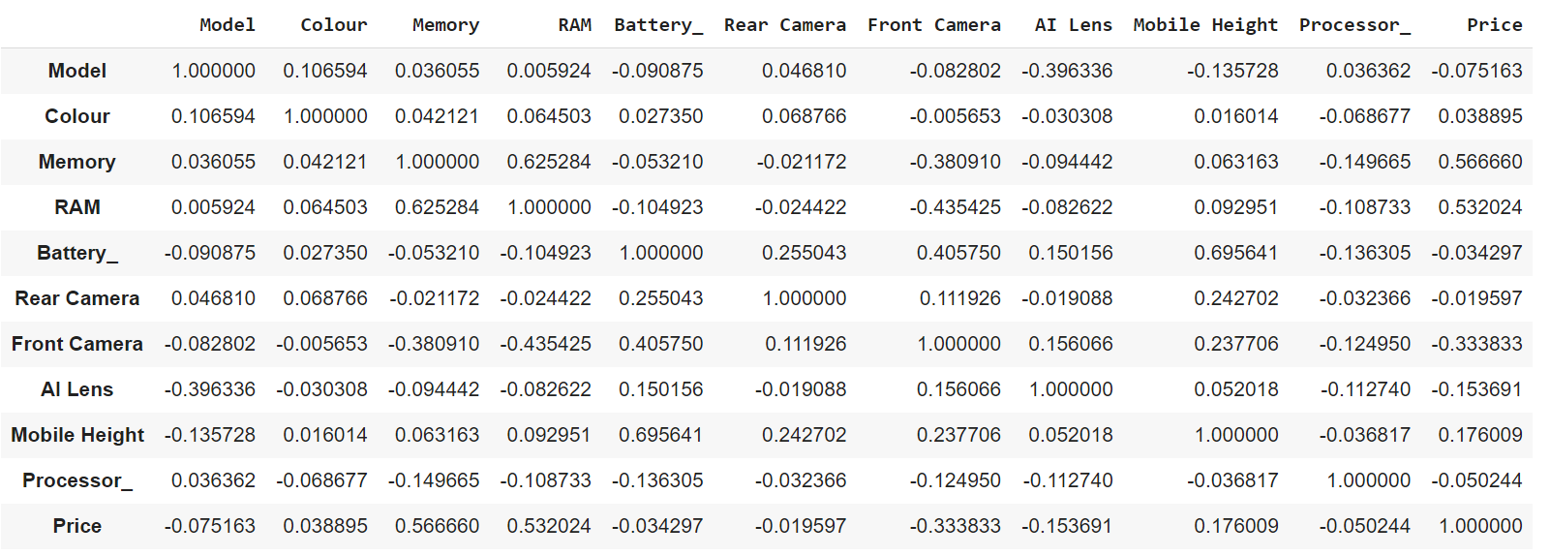
Based on high degree of positive correlation-key features related to price are Memory RAM Mobile Height

Slide 11
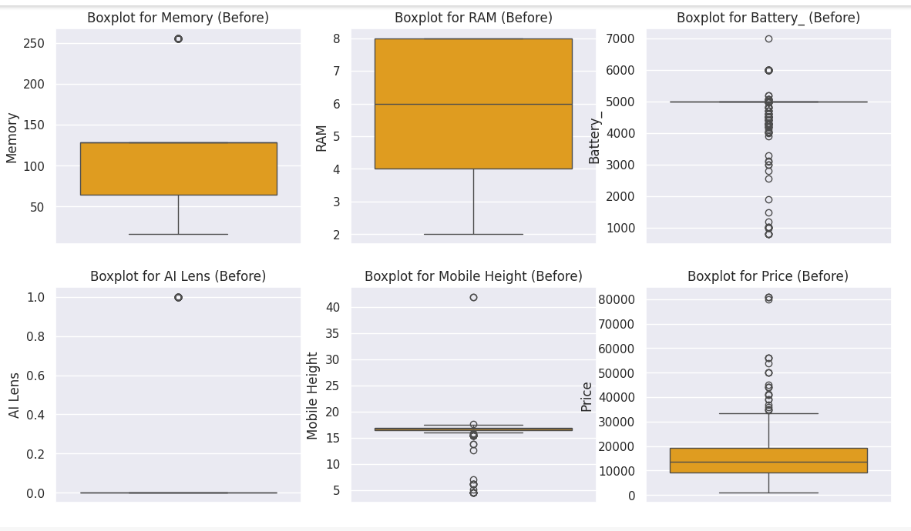
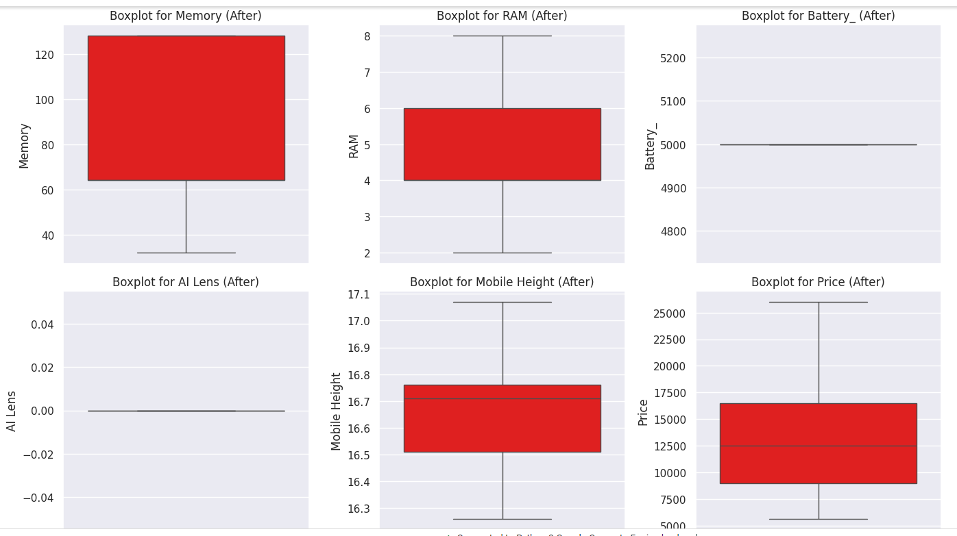
Outliers before and after
Most features had visible outliers before the removal process .
After removel boxplots shows more compact distribution reflecting a cleaner dataset
AI lens was largely unaffected .

Slide 12
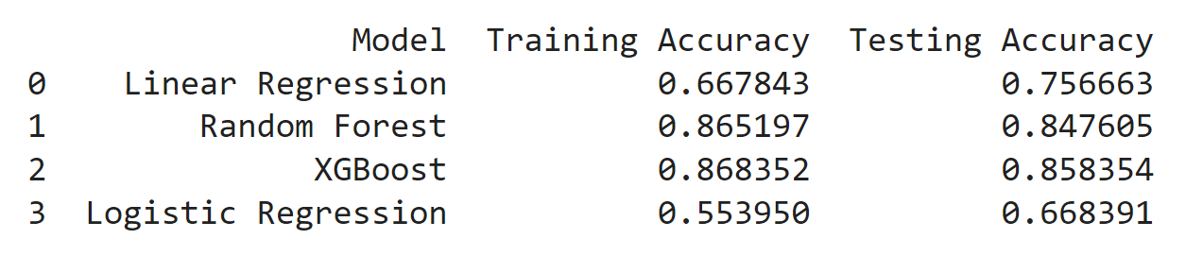
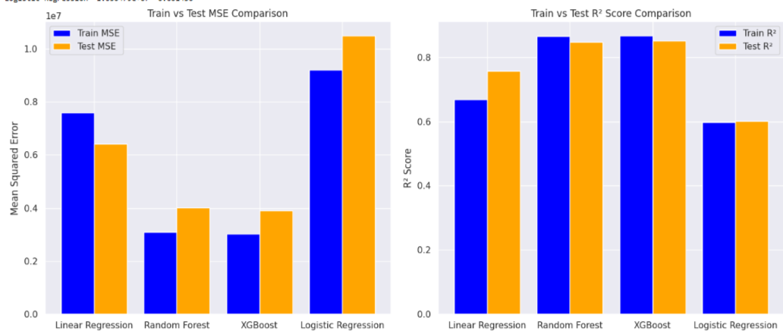
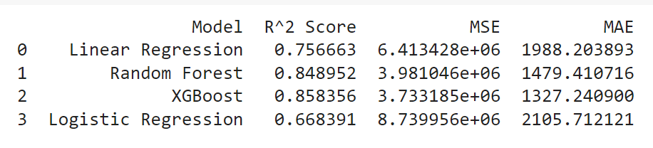
Best Performing Model: XGBoost has the lowest testing MSE (3.915133e+06). The training MSE for XGBoost is also low (3.031372e+06), indicating it performs well on both training and test data. Therefore, XGBoost is the best-performing model based on the provided MSE values

Slide 13
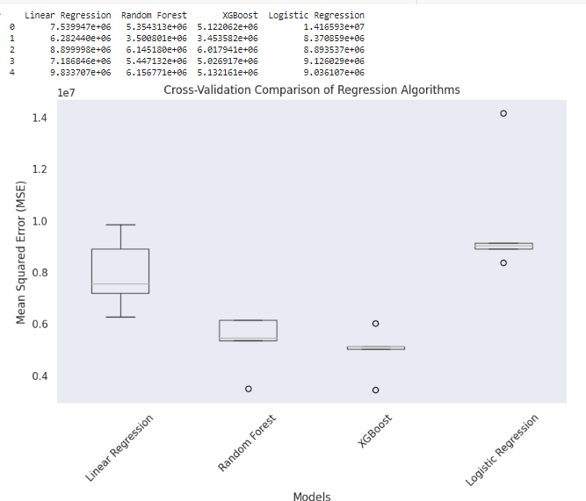
Cross validation comparision

Slide 14
Conclusion :-
8GB RAM is the most common while 4GB RAM is also having common among the cell phones
Realme C55 have maximum occurrences.
Qualcomm SnapDragon Processor are mostly used in cell phones.
Most of the cell phones are affordable and within a specific price range, but few are very expensive.
XGBoost Model shows lower test MSE compare to other model, so it is making more accurate predictions.

Slide 15
Thank You

